Slide 1
^{Why Choose Music?}

Slide 2
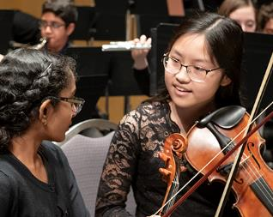
Why Choose Music?
Music students have fun while they learn.
^{They also:}
Experience joy making music with their friends.
Express their emotions in an inviting and encouraging space.
Learn how to collaborate with others and champion their successes.
Study the music of many cultures, building awareness and respect of all others.

Slide 3
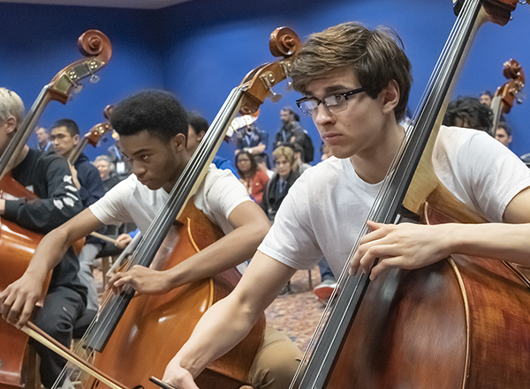
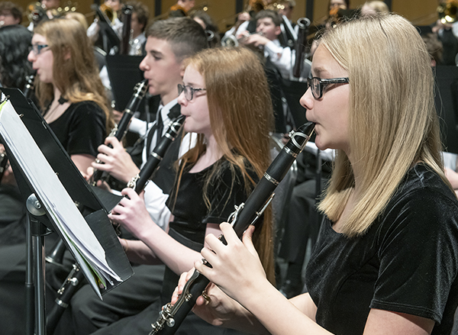
Why Choose Music?
Music students have fun while they learn.
^{They also:}
Improve in other academic subjects as well.
Make lifelong friends through musical collaboration.
Develop musical independence so music can always be part of their life.
Build the skills and perseverance needed for success in every future endeavor.

Slide 4
Why Choose Music?
It’s not just about pursuing a career in music
“The theory of relativity occurred to me by intuition, and music is the driving force behind this intuition. My parents had me study the violin from the time I was six. My new discovery is the result of musical perception.”
Albert Einstein, Theoretical Physicist

Slide 5
Why Choose Music?
It’s not just about pursuing a career in music
“It is in Apple’s DNA that technology alone is not enough—it’s technology married with liberal arts, married with the humanities, that yields us the results that make our heart sing.”
^{Steve Jobs, Apple Inc.} ^{Co-founder}

Slide 6
Why Choose Music?
It’s not just about pursuing a career in music
“I believe the foundation for any success I have had is derived more from my music education than my engineering study.”
^{David Borland} ^{Former Amazon Web Services}
Director of Machine Learning Acceleration

Slide 7
Why Choose Music?
Middle schooler Emma says music is like a language—you can tell a story with it.
While it teaches skills like focus and hard work, music also brings people together like a family.
https://youtu.be/U93BbIZ_vxA

Slide 8
Why Choose Music?
When Jamsel got into middle school music, he felt welcomed and found the place where he belonged.
Now he wants to be a band director so he can share his passion with others.
https://youtu.be/OPcmjx_lzAQ

Slide 9
Why Choose Music?
Joyce says the best part of music is being a part of something bigger than yourself.
She plans to go to medical school and knows music will always be part of her life.
https://youtu.be/MdxjENsKpQY

Slide 10
Questions About Choosing Music?
Contact <Director Name> to learn more.
[insert program logo image]

